Slide 1
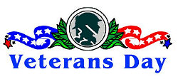
2014

Slide 2
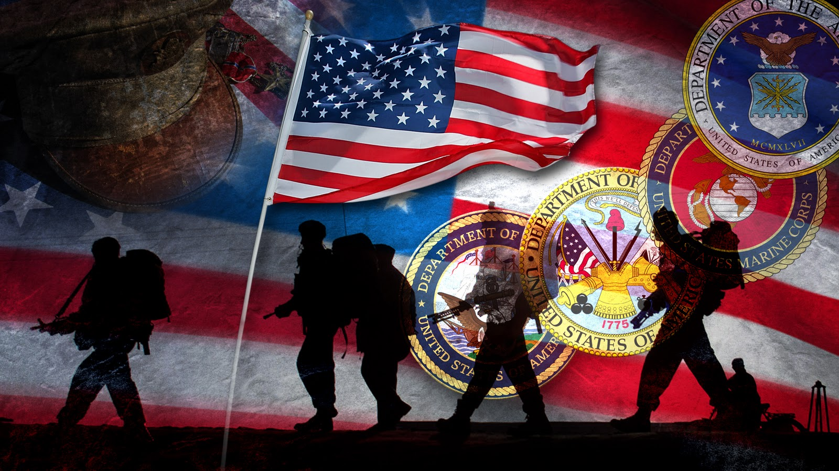
An Explanation of Veterans Day
http://www.history.com/topics/holidays/history-of-veterans-day/videos/history-of-veterans-day

Slide 3
Armistice Day
Veterans Day was once called
Armistice Day.
Armistice Day is commemorated every year on November 11th, to mark the treaty (or armistice) signed between the Allied and German forces of World War I, which took effect at eleven o'clock in the morning—the "eleventh hour of the eleventh day of the eleventh month" of 1918.

Slide 4
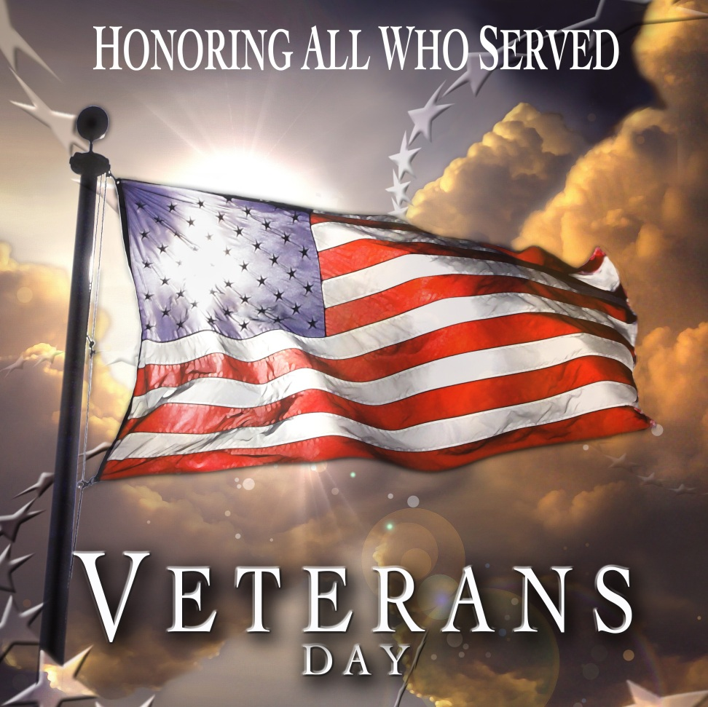
After More Wars, the Name Changed
In 1954, after having been through both World War II and the Korean War, the Congress amended the name of the holiday, changing "Armistice” to the word, "Veterans." With the approval of this legislation on June 1, 1954, Nov. 11 became a day to honor American veterans of all wars.

Slide 5
Who are our veterans today?

Slide 6
Wars of the 20th and 21st Century
World War I—none still living
World War II--16,112,566 served, about 1 million still alive
Korean War--5,720,000, about 2,275,000 still living
Vietnam War--8,744,000, about 7,391,000 still living
Desert Shield/Storm--2,322,000, with 694,550 deployed to Gulf
Global War on Terror-varies because of ongoing conflict
CURRENT VETERANS IN THE UNITED STATES:
Approximately 21.2 million

Slide 7
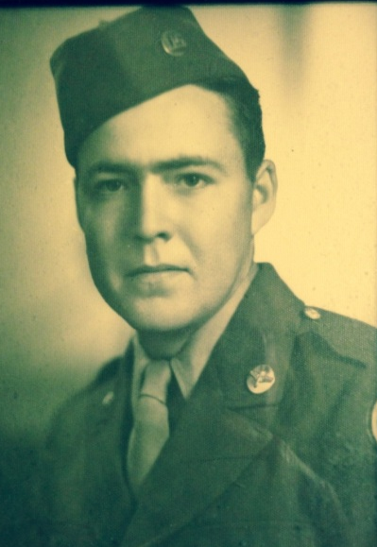
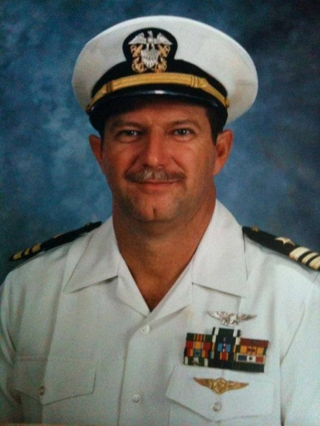
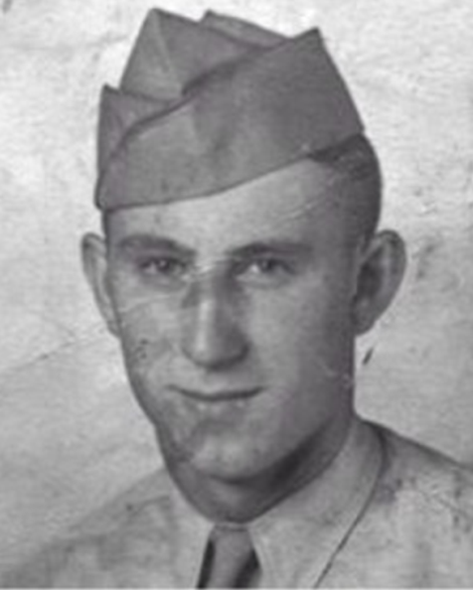
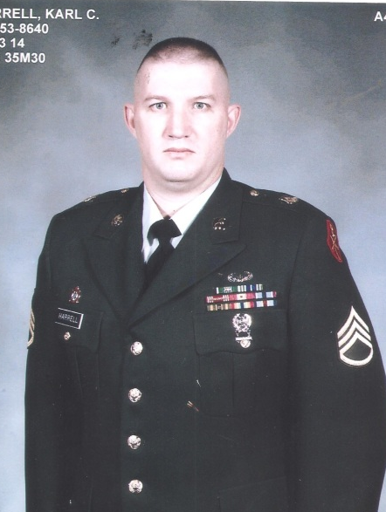
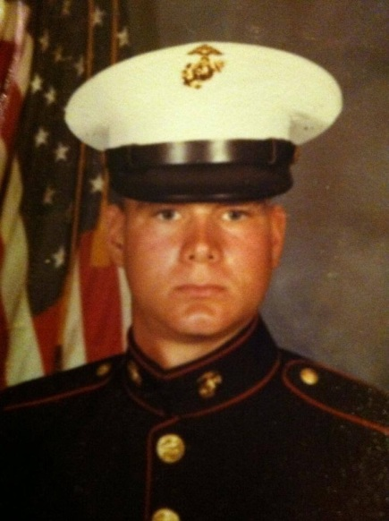
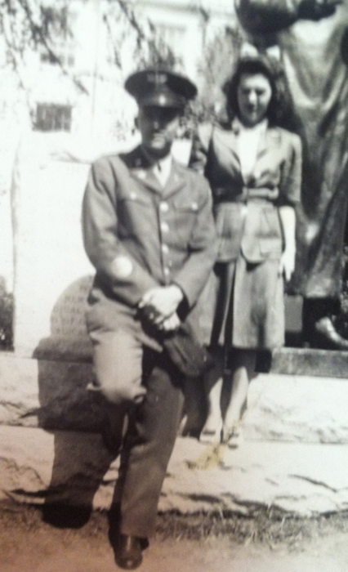
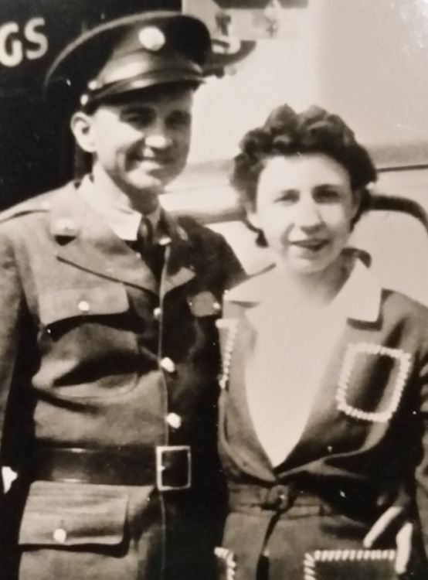
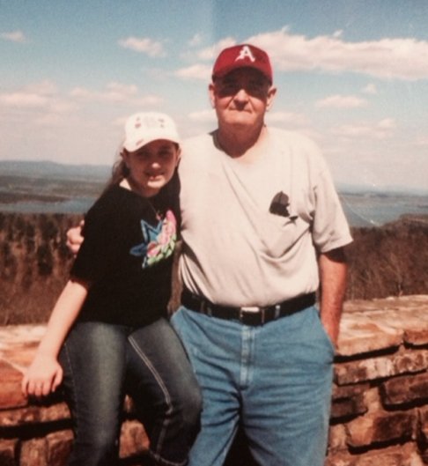
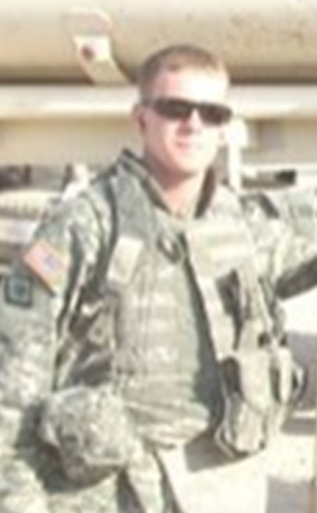
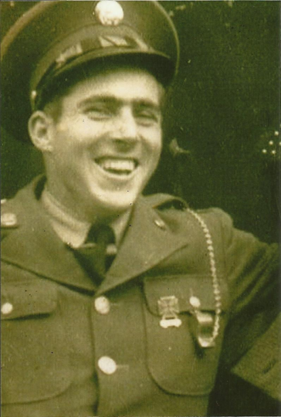
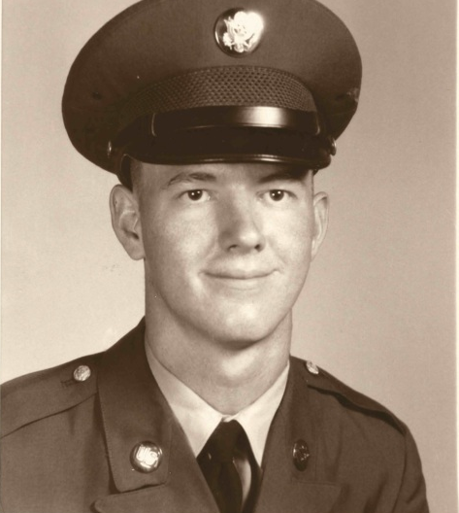
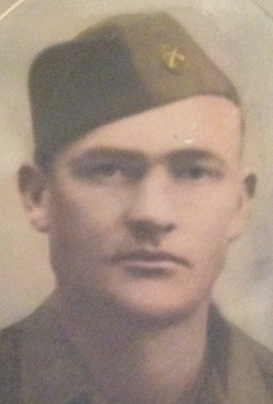
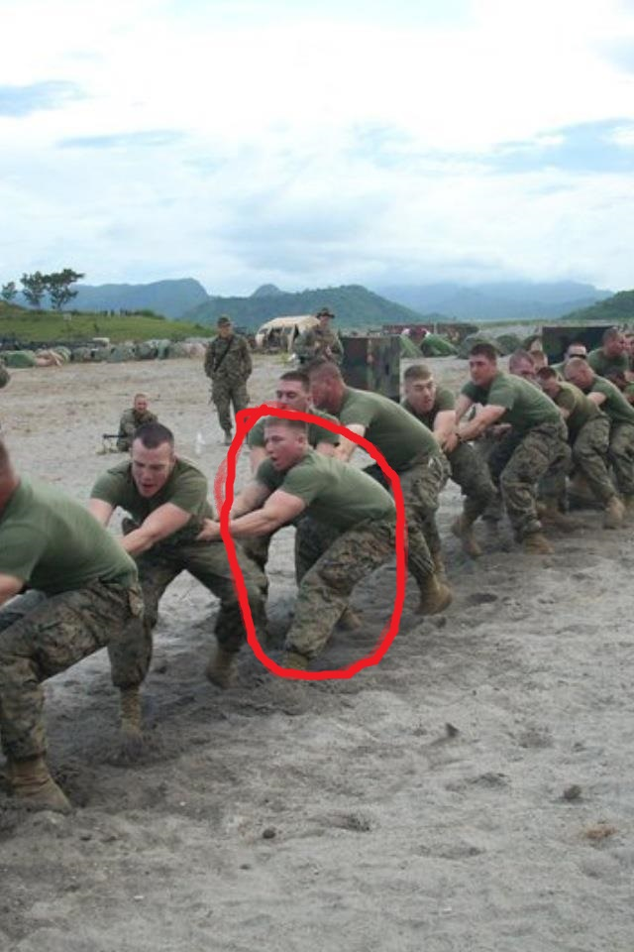
Our Veterans

Slide 8
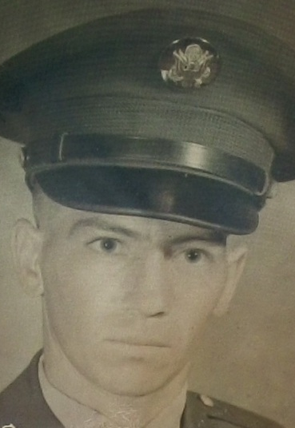
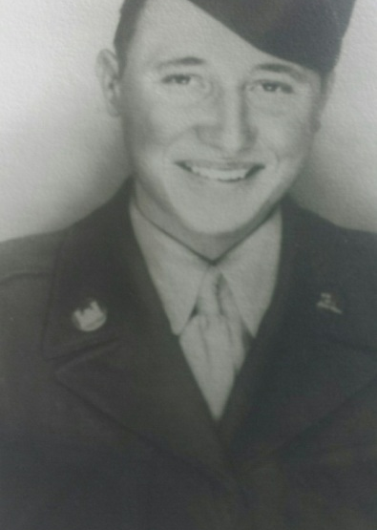
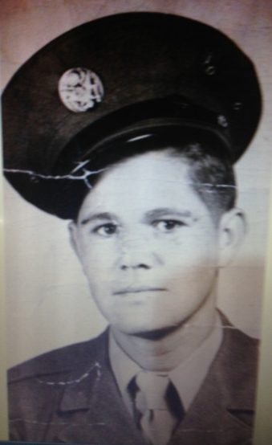
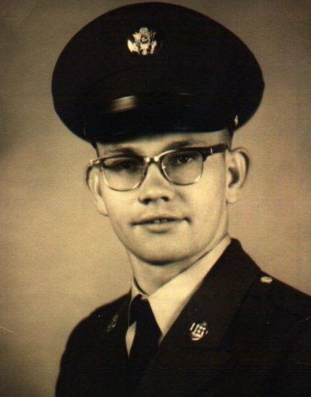
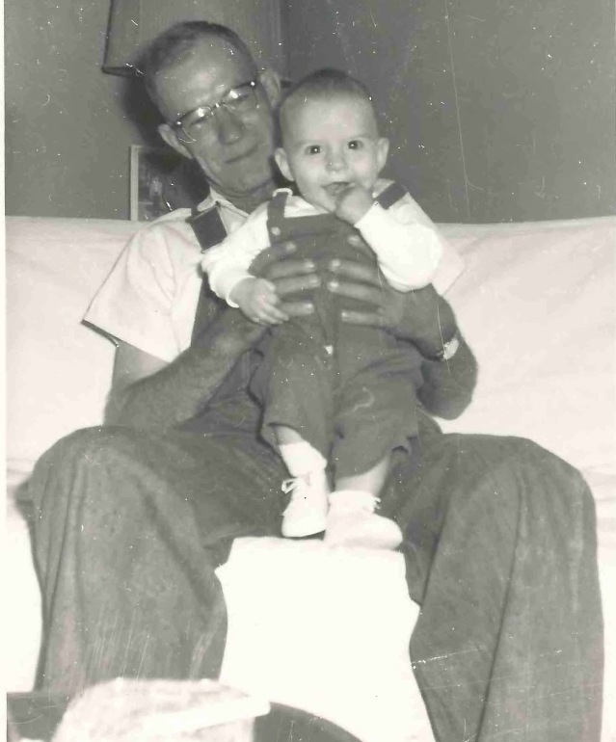
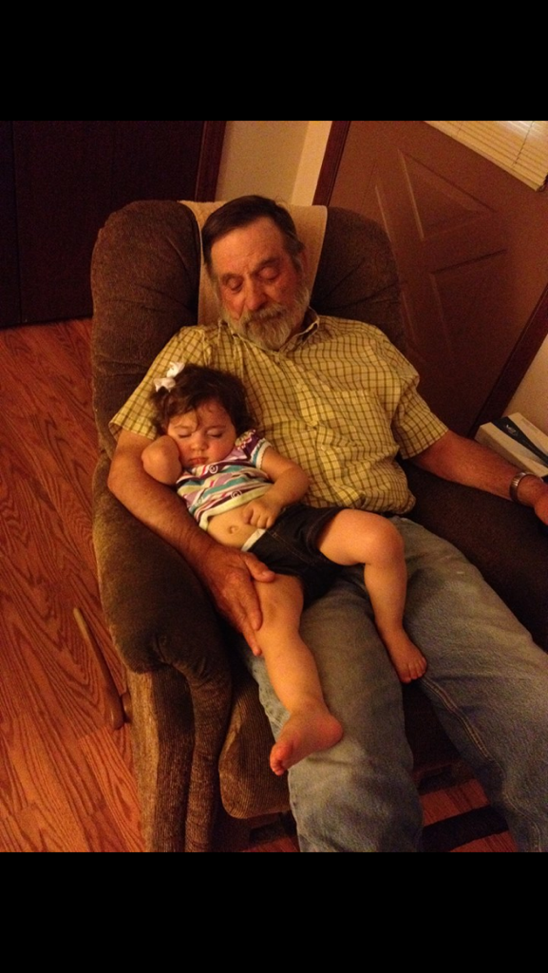
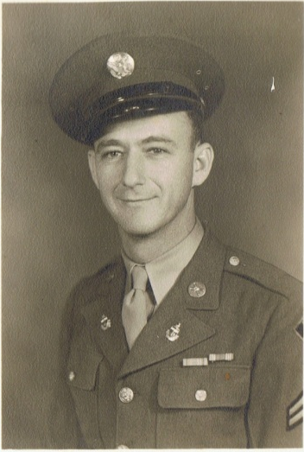
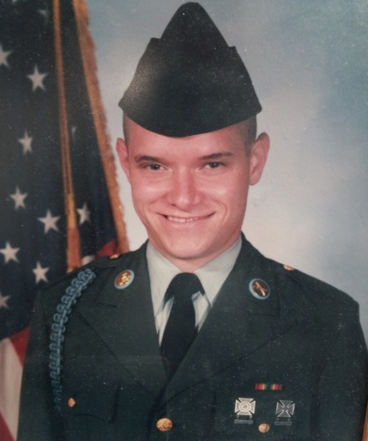
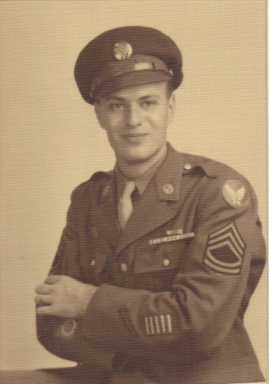
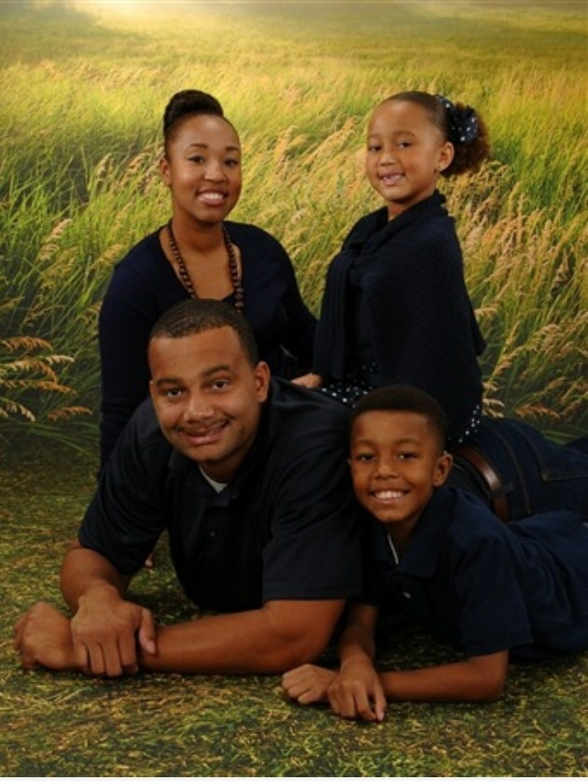
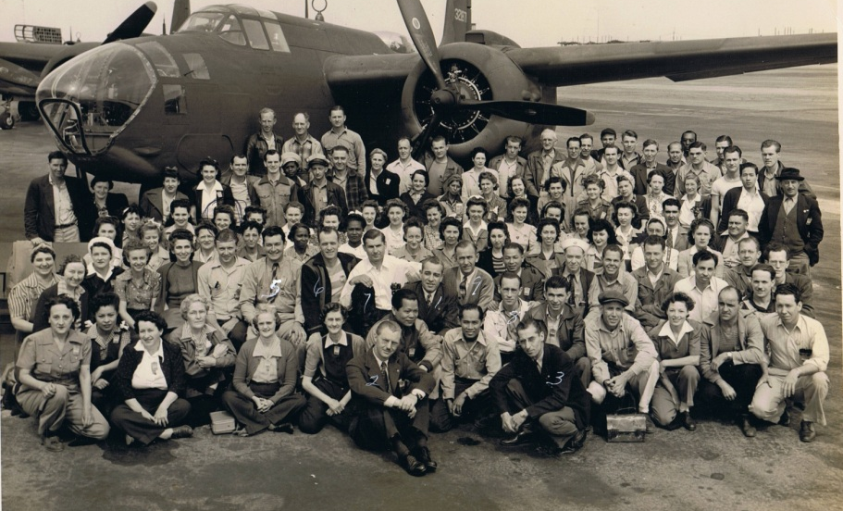
All
Our
Respect

Slide 9
Sources:
www.military.com
www.educationworld.com
www.hellasmultimedia.com
www.wikepedia.org
www.cnn.com
www.va.gov

